Slide 1


NPM, Yarn
Et si la vérité Etait ailleurs ?
Notes:
Bonjour à tous,
Merci d’être encore présent pour cet avant-dernier quickie du devfest 2017. je salue les courageux et garder espoir la keynote de fin est toute proche.
Donc bienvenue dans cette session consacré aux gestionnaires de paquet.
On va commencer par un petit sondage

Slide 2

Notes:
Qui connais NPM ?

Slide 3

Notes:
Qui connais YARN de Facebook ?

Slide 4

Notes:
Qui connais PNPM ?
Qui connais PNPM avant d’avoir lu l’abstract de la conf ?

Slide 5

I Want to believe…
Vincent piard ○ MEAE
Naoned Makers
@lynchmaniacPL
Notes:
Précisé ex-SQLI

Slide 6

Installation
curl -L https://unpkg.com/@pnpm/self-installer | node
npm install -g pnpm

Slide 7

Philosophie PNPM
APP
A v1.0
B v1.0
C v1.0
B v2.0
APP
A v1.0
B v1.0
C v1.0
B v2.0
NPM v2 (jusquà mi-2015)
NPM v3..5 (à partir de juin 2015)
Notes:
Performant Node Package Manager
Gestionnaire de paquet crée en janvier 2016 fork eid par Rico Cruz
26 contributeurs dont 4 principaux
Pnpm issus de ied (qui voulait réimplémenter npm's pre-v3 install algorithm en réaction aout 2015)
pnpm was basically based on ied, a project by Alexander Gugel. ied was created in the middle of 2015 and used a flat storage of packages under node_modules. From that storage packages were then symlinked around to create a nested dependency tree, like the one created by npm2.
At the beginning of 2016, Rico Sta. Cruz has created pnpm, which was using a similar approach but with more emphasis on compatibility with the existing Node.js ecosystem. For instance, unlink ied, pnpm was supporting peer dependencies.
Although both projects had an initial popularity spark, they were basically unmaintained by mid 2016. In mid 2016, Zoltan Kochan has stumbled upon pnpm and tried it at work. It did not work. However, it was more than 10 times faster than npm, so he started contributing to it. By the time of Yarn's public release, the pnpm repo had 100 solved issues and it was a fairly well-functioning npm alternative. Even though Yarn was slower than pnpm, the pnpm team decided that it needed a second killer-feature, that would make it the superior package manager: a shared store. So by January 2017, pnpm was basically rewritten to use a shared store by default.

Slide 8
INSTALL
LIST
INSTALL-TEST
UPDATE
UNINSTALL
PRUNE
LINK
APIs
Notes:
Les seules API réimplémenter par PNPM

Slide 9
INIT
LIST
INSTALL
INSTALL [PACKAGE]
UPDATE [PACKAGE]
UNINSTALL [PACKAGE]
VIEW [PACKAGE]
INSTALL -g [PACKAGE]
RUN [SCRIPT]
PNPM
INIT
LIST
INSTALL
INSTALL [PACKAGE]
UPDATE [PACKAGE]
UNINSTALL [PACKAGE]
VIEW [PACKAGE]
INSTALL -g [PACKAGE]
RUN [SCRIPT]
NPM
INIT
LIST
INSTALL
ADD [PACKAGE]
UPGRADE [PACKAGE]
REMOVE [PACKAGE]
INFO [PACKAGE]
GLOBAL ADD [PACKAGE]
RUN [SCRIPT]
YARN
APIs

Slide 10

Programmatic API
Notes:
Utilisation de SUPI pour utiliser programmatiquement pnpm

Slide 11
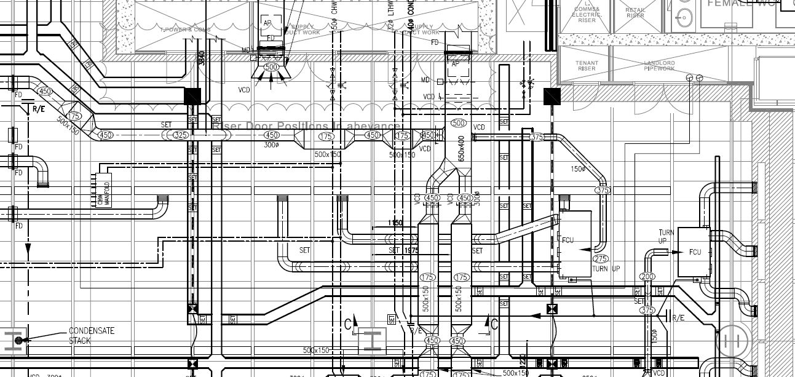
PNPM Sous le capot
Notes:
NPM faire les liens sympbolique soit même
Expliquer Fiabilité => shrinkwrap.yaml (le montrer)
pnpm relie tous les modules nécessaires du magasin dans les projets node_modules. Après cela, il crée l'arbre de dépendance en utilisant des liens symboliques. L'arbre de dépendance n'est pas plat. Il semble plat parce qu'il a une profondeur constante. Il peut avoir une profondeur constante car les paquets sont liés par des liens symboliques dans les dossiers node_modules de l'autre, et non copiés / collés

Slide 12



PNPM Sous le capot
STORE
REGISTRY
MODULES
HARD LINK
SYMLINK
JUNCTION

Slide 13
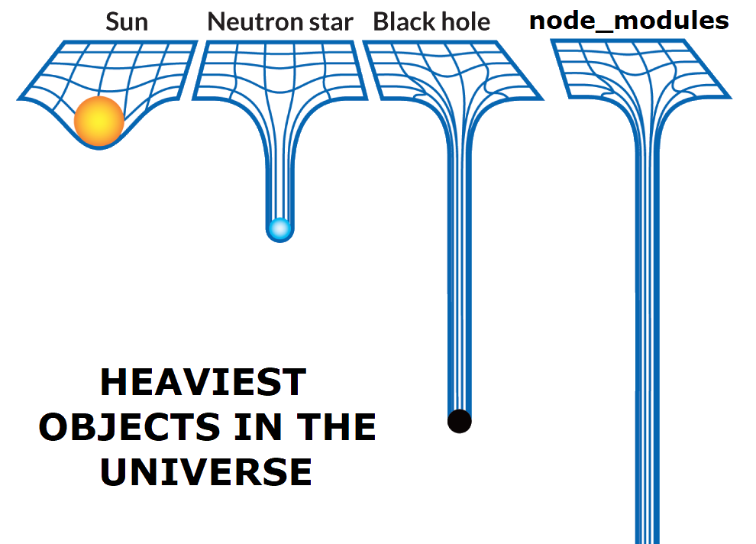
Node modules
Heaviest objects in the universe

Slide 14
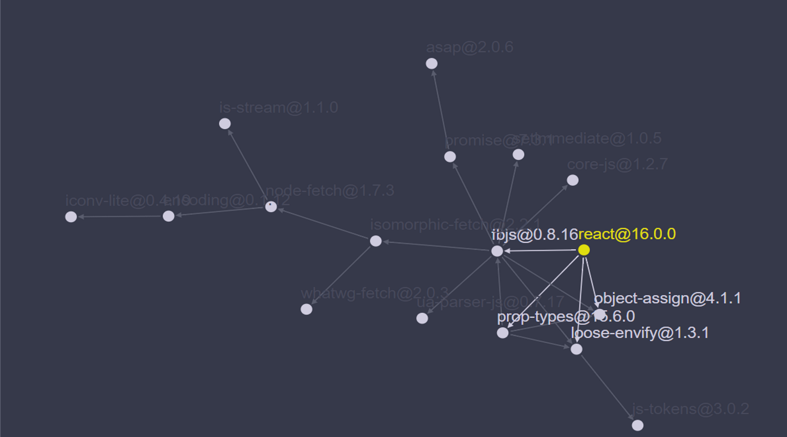
HOOKS

Slide 15


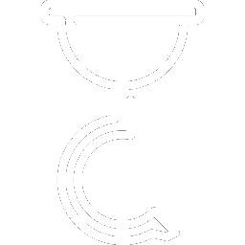
Atouts
SIMPLICITE
ESPACE DISQUE
HOOKS
VITESSE

Slide 16

Le Benchmark !

Slide 17
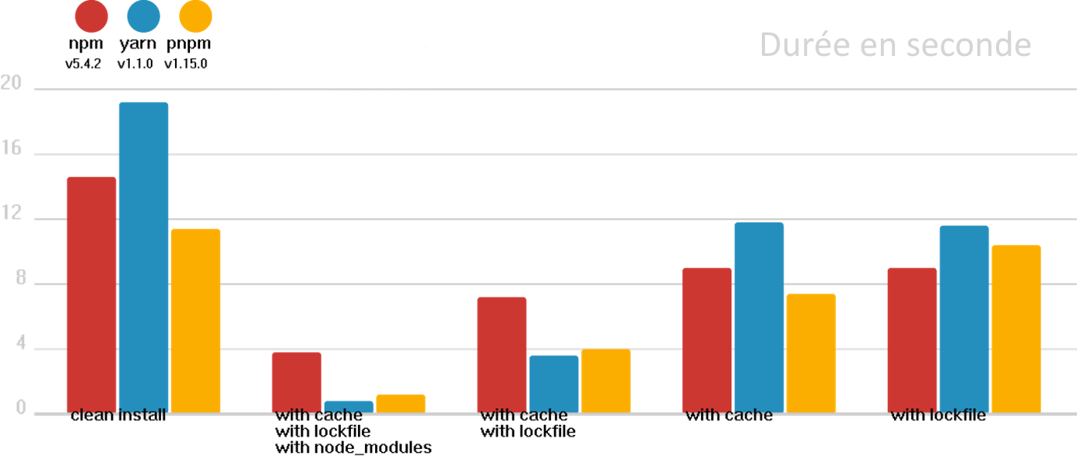
Angular APP
Le Benchmark !

Slide 18
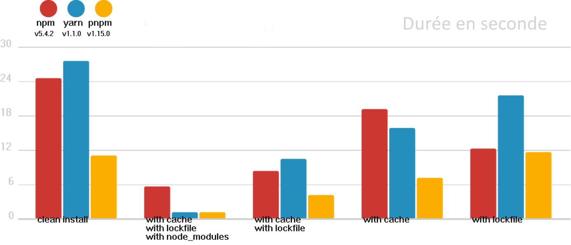
React APp
Le Benchmark !

Slide 19
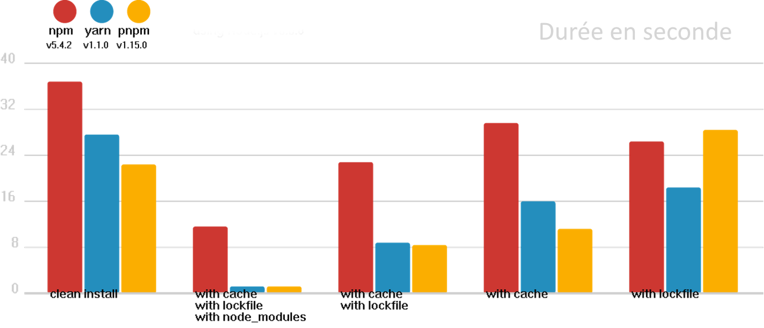
Ember APP
Le Benchmark !

Slide 20
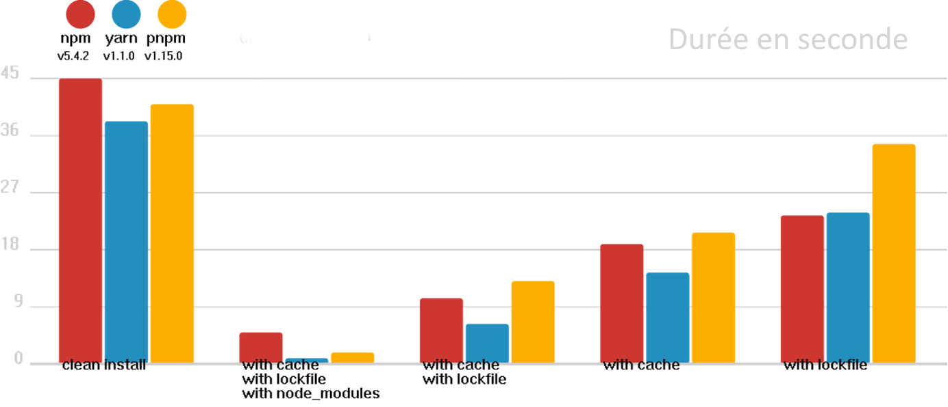
Medium size APP
Le Benchmark !

Slide 21
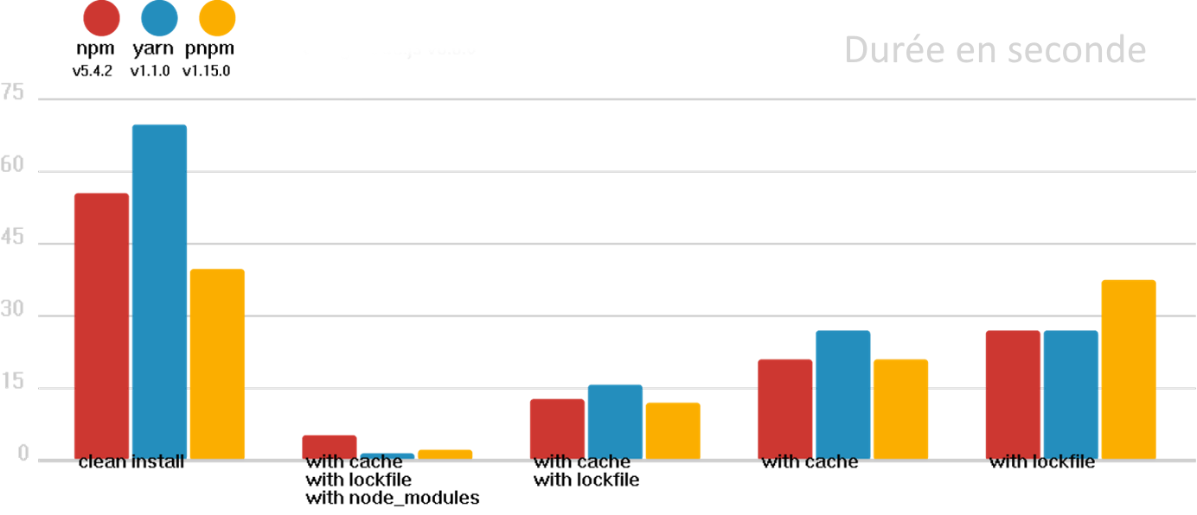
A LOT FILE APP
Le Benchmark !

Slide 22




Limitations
Bundle Dependencies
Preserve symlinks
Module incompatible
Intégration
Notes:
npm-shrinkwrap.json and package-lock.json are ignored. Unlike pnpm, npm can install the same name@versionmultiple times and with different sets of dependencies. npm's shrinkwrap file is designed to reflect the node_moduleslayout created by npm. pnpm cannot create a similar layout, so it cannot respect npm's lockfile format.
You can't publish npm modules with bundleDependencies managed by pnpm.
Binstubs (files in node_modules/.bin) are always shell files not symlinks to JS files. The shell files are created to help pluggable CLI apps in finding their plugins in the unusual node_modules structure. This is very rarely an issue and if you expect the file to be a js file, just reference the original file instead, as described in #736.
Node.js doesn't work with the --preserve-symlinks flag when executed in a project that uses pnpm.

Slide 23
Conclusion

Slide 24

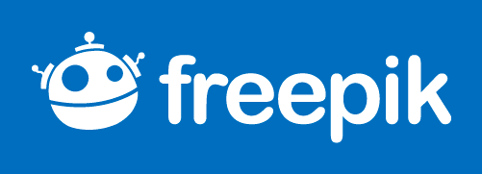
CREDITS
Couverture : Billy Meier http://www.alienscientist.com/pictures/Billy_Meier.jpg
Benchmark : http://s1.1zoom.me/big3/849/Men_Arm_WrestlingLittle_465538.jpg
Graph : made by pnpm
Icons made by freepik and Flaticon

